Slide 1
NCAA Tournament Machine Learning

Slide 2

What is Machine Learning?

Slide 3
Purpose
The purpose of this lunch and learn is for attendees to gain a deeper understanding of what is involved in machine learning
Not how to code
Not which machine learning algorithms are “best”
Not to win NCAA tournament pools

Slide 4
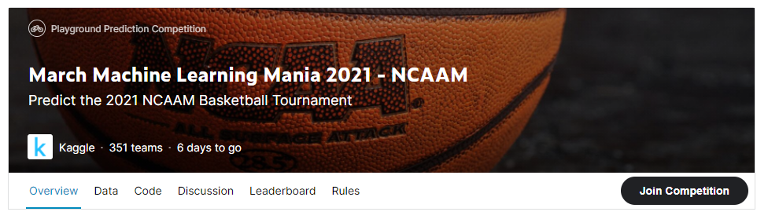
Official Competition

Slide 5

Use Jupyter Notebooks

Slide 6
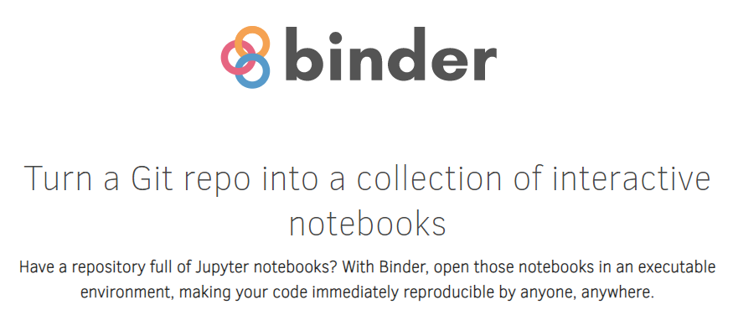
Binder allows running Jupyter Notebooks in the cloud

Slide 7
Link to notebook
https://mybinder.org/v2/gh/thekevster08/MarchMadness/master

Slide 8
Quick Disclaimer
This is a difficult problem (especially first problem)
Do not bet money with this bracket. You will lose

Slide 9
Cut to notebook
Link here:
https://mybinder.org/v2/gh/thekevster08/MarchMadness/master

Slide 10
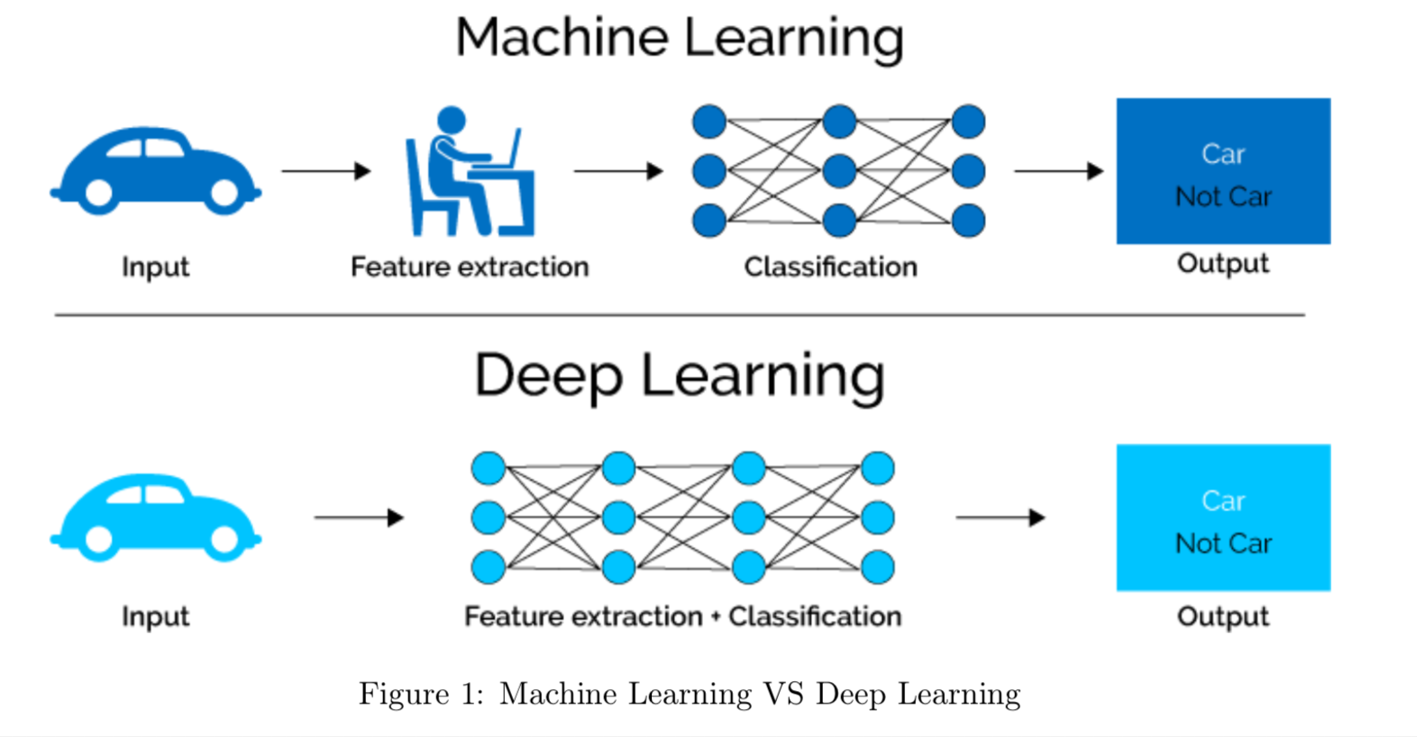
What is Machine Learning?

Slide 11

Types of Machine Learning
Notes:
We are going to be working in the supervised learning space. This is made up of classification and regression. Classificatoin is if you want to know if something belongs to a category. Say you are coming up with an algorithm to determine the picture is a dog or a cat. Or is it a hot dog?

Slide 12

isthisacat.com

Slide 13
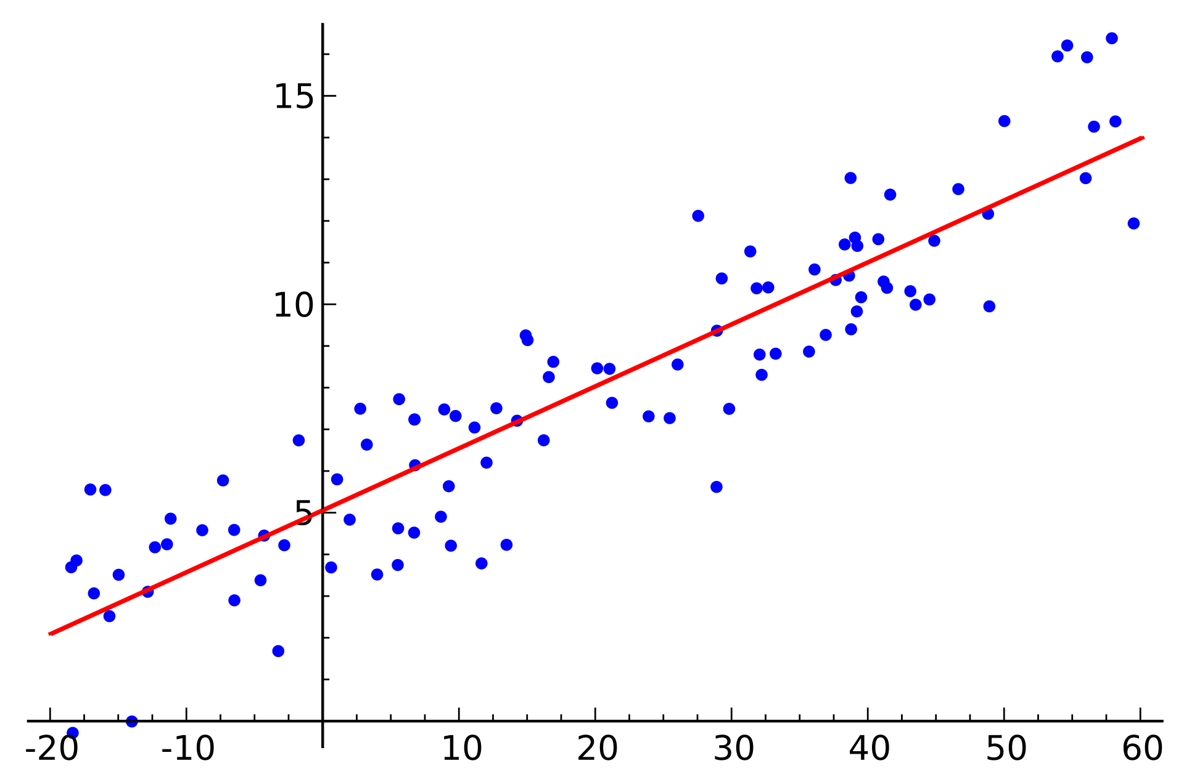
Example of Regression

Slide 14
Back to notebook

Slide 15

We will be using scikit learn

Slide 16


Major Machine Learning Libraries

Slide 17
Back to notebok

Slide 18
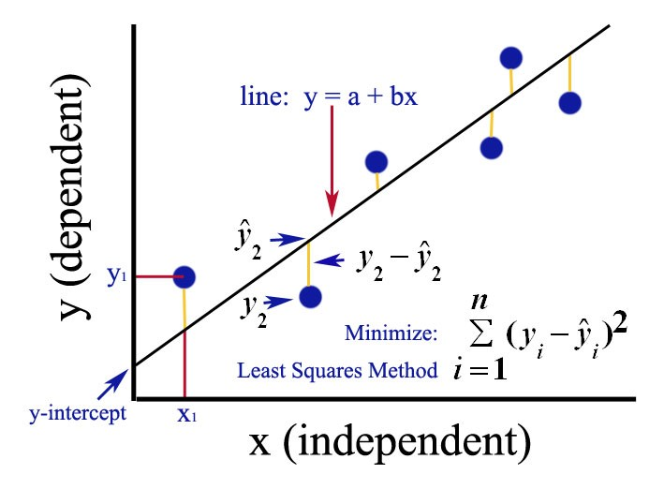
Ordinary Least Squares

Slide 19
Back to notebook

Slide 20
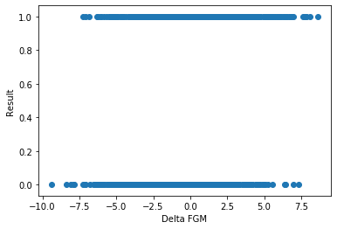
Recall Categorical Data

Slide 21

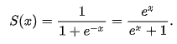
Sigmoid Function

Slide 22
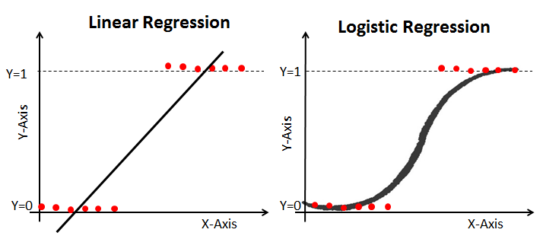
Logistic Regression

Slide 23
Back to notebook

Slide 24
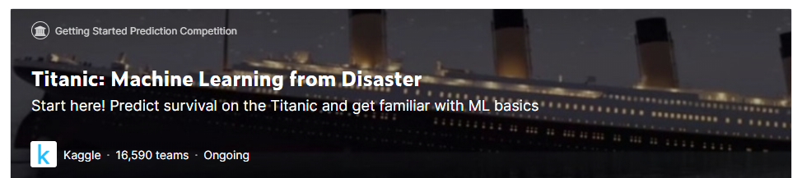
Kaggle – Titanic Challenge

Slide 25
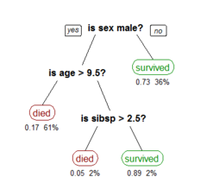
Decision Tree Classifier

Slide 26
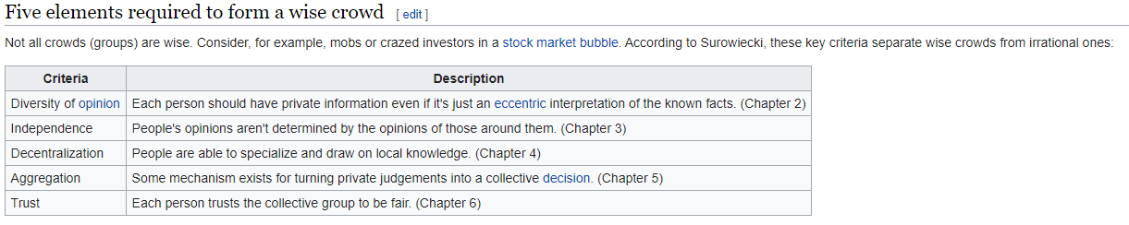
Wisdom of Crowds

Slide 27
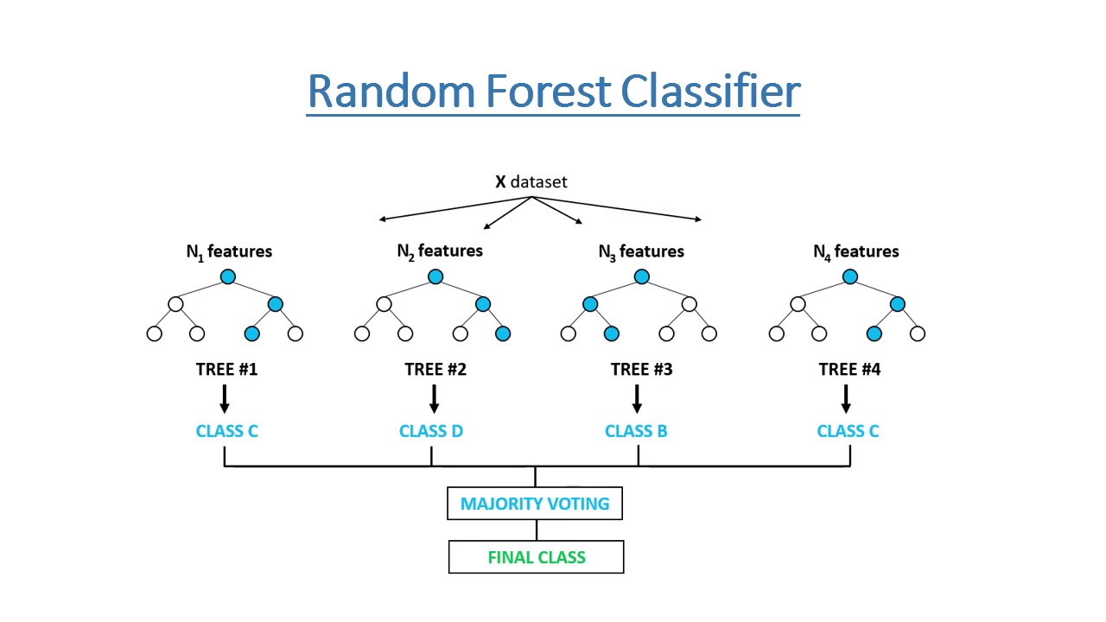
Random Forest Classifier

Slide 28
Back to notebook

Slide 29
What is deep learning?

Slide 30
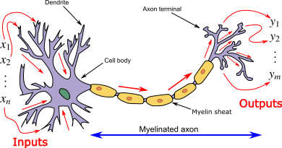
A neural network mimics an actual neuron

Slide 31

Neural Network Architecture

Slide 32
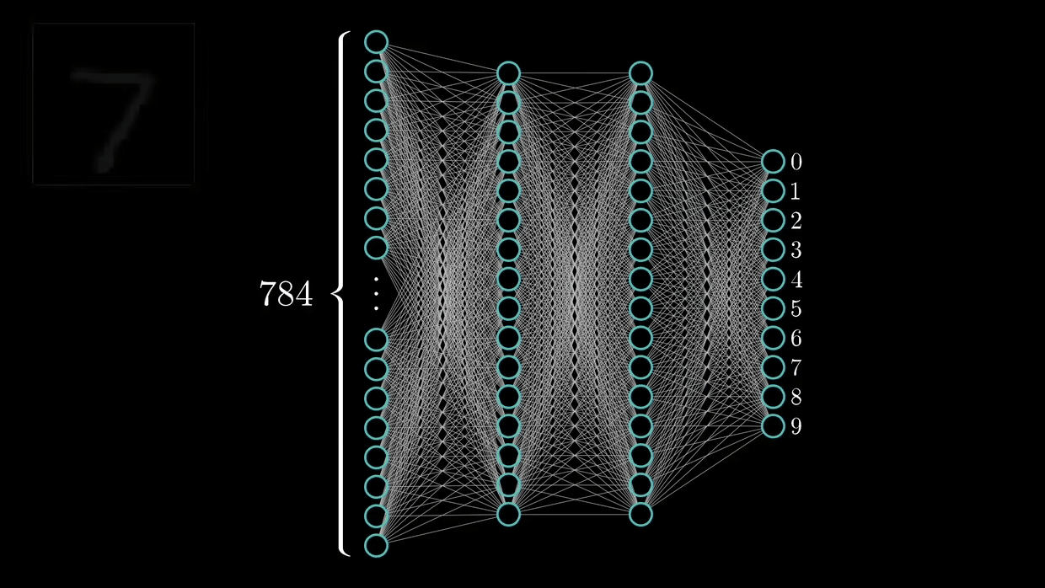
Training a Neural Network

Slide 33
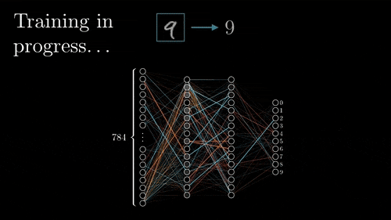
Back Propogation

Slide 34
To notebook

Slide 35
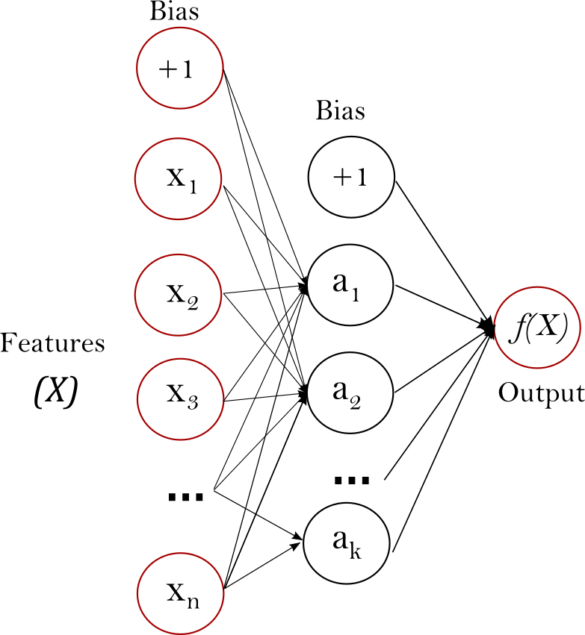
Scale Your Features!

Slide 36
To notebook

Slide 37
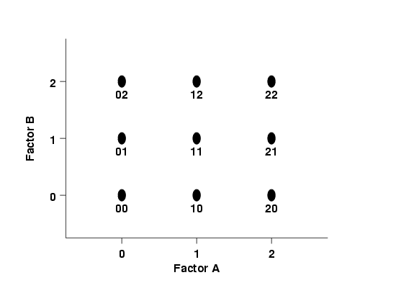
DOE Fundamentals

Slide 38
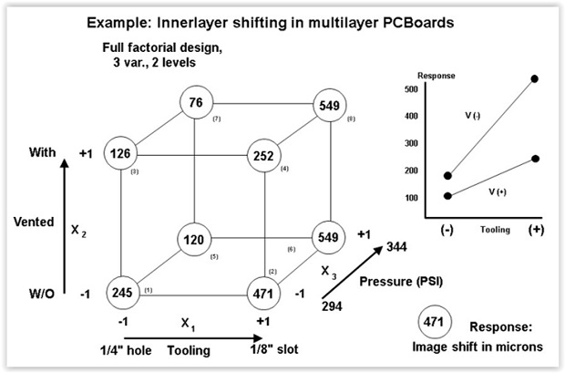
DOE Fundamentals

Slide 39
To Notebook

Slide 40
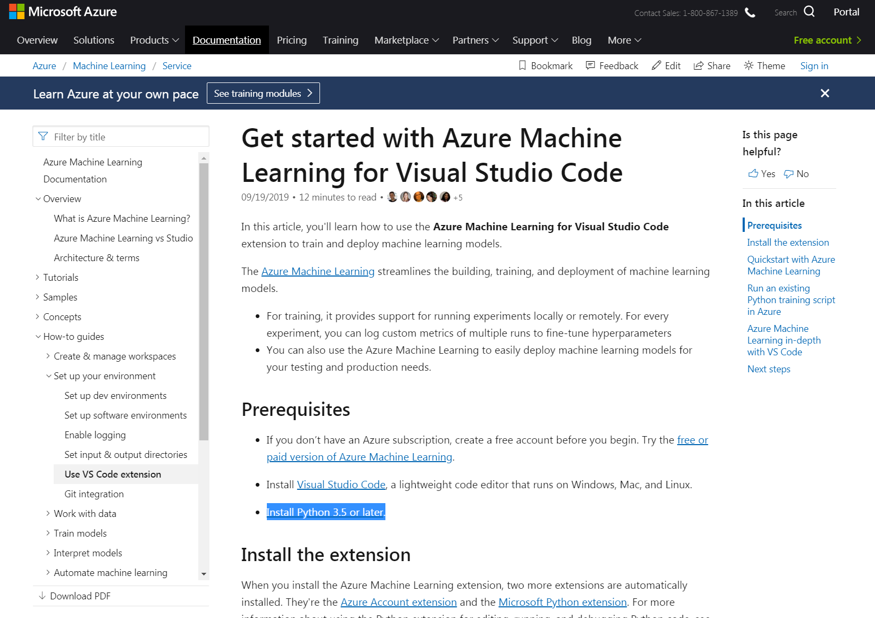
Microsoft’s Machine Learning Tool

Slide 41
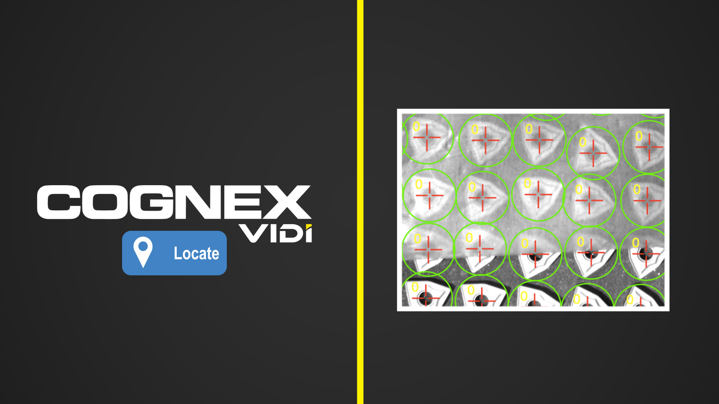
Cognex Vidi
Cognex Uses ViDi, Proprietary Deep Learning software

Slide 42
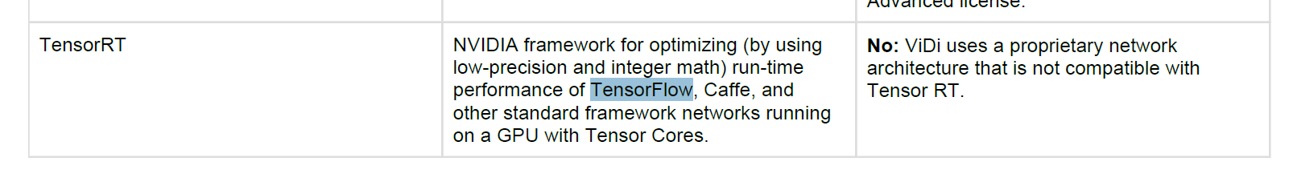
Cognex Vidi
ViDi’s “proprietary” algorithm is based on TensorFlow

Slide 43
Back to notebook

Slide 44
Source Material
https://github.com/cshaley/bracketeer
https://www.kaggle.com/juliaelliott/basic-starter-kernel-ncaa-men-s-dataset

Slide 45
Conclusion!
Thanks for Attending
Will have again next year, so feedback is welcome!
Visit Kaggle.come to learn more

Slide 46
Teaser presentation

Slide 47
Explore Several Types of Models
Neural Network
Random Forest Classifier
Linear Regression
Logistic Regression
Decision Tree Classifier

Slide 48
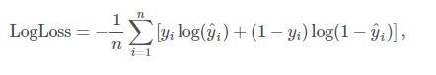
Contest Part 1 – Log Loss of Predictions
ID | Pred
2019_1101_1113 | 0.6
2019_1101_1120 | 0.2
2019_1101_1124 | 0.5
2019_1101_1125 | 0.5
2019_1101_1133 | 0.9
2019_1101_1138 | 0
2019_1101_1153 | 0.1
2019_1101_1159 | 0.7
2019_1101_1181 | 0
2019_1101_1192 | 0.8
2019_1101_1196 | 0.5
2019_1101_1199 | 0.4
2019_1101_1205 | 0.8
2019_1101_1209 | 0.6
2019_1101_1211 | 0
2019_1101_1222 | 0.1
2019_1101_1233 | 0.6
2019_1101_1234 | 0.4
2019_1101_1235 | 0.1
2019_1101_1242 | 0.2
2019_1101_1243 | 0.1
2019_1101_1246 | 0
2019_1101_1251 | 0.5
2019_1101_1257 | 0
n is the number of games played
y^i is the predicted probability of team 1 beating team 2
yi is 1 if team 1 wins, 0 if team 2 wins
log() is the natural (base e) logarithm
*2279 combinations

Slide 49
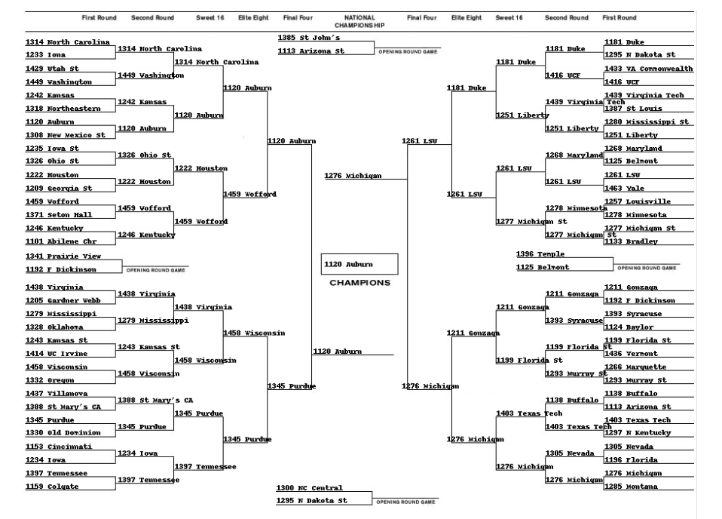
Contest Part 2 – Bracket

Slide 50
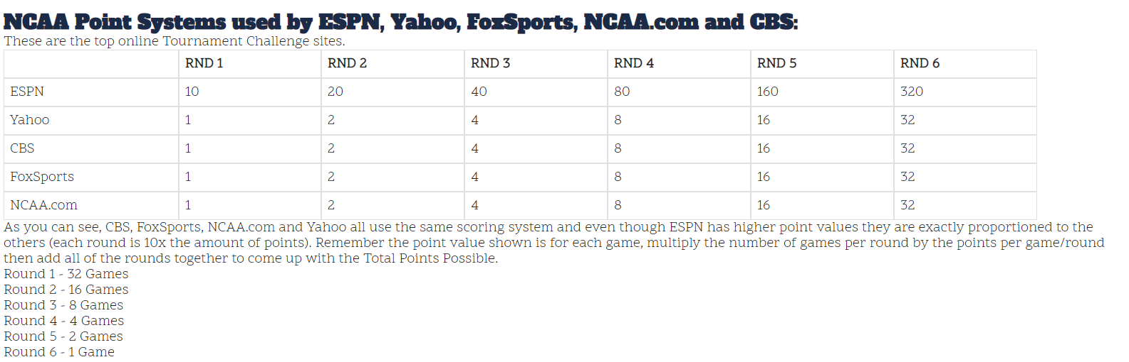
Contest Part 2 – Bracket

Slide 51
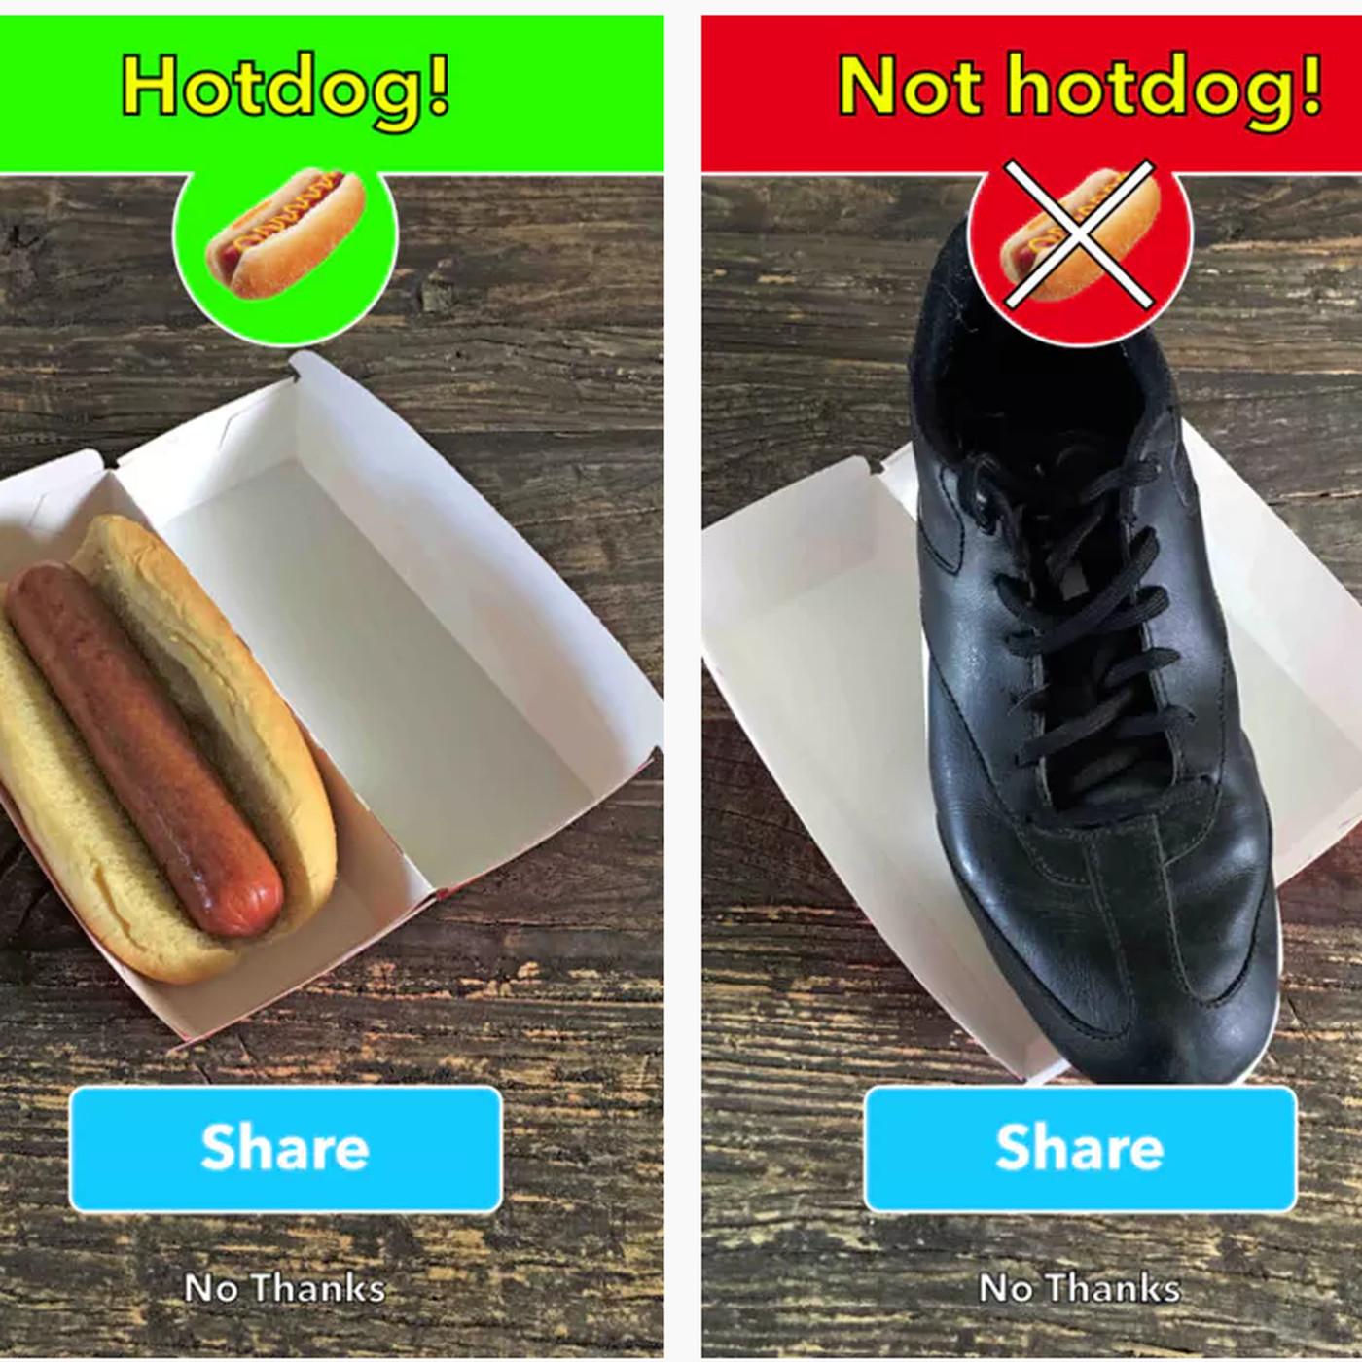

Example of Classification

Slide 52

Questions?

Slide 53
